Slide 1
23I412-EMBEDDED SYSTEM LABORATORY MINI PROJECT ON AUTOMATIC PLANT WATERING SYSTEM
R.LAKSHWANTHI DEVI-23I231
T.R.CHARISMA-23I209

Slide 2
INTRODUCTION
Project Purpose: The main aim of this project is to design a smart system that automatically waters plants based on soil moisture levels.
It ensures that plants receive water only when needed, helping prevent overwatering or underwatering.
Importance of Automation in Plant Care: Manual watering can be inconsistent or forgotten, especially in busy or remote environments.
Automation helps maintain healthy plant growth by providing the right amount of water at the right time.
It also saves time and conserves water.
Role of Raspberry Pi Pico: The Raspberry Pi Pico acts as the brain of the system.
It reads data from the soil moisture sensor and controls the water pump through a relay module.
With its low power consumption and real-time processing capabilities, it is ideal for this kind of embedded application.

Slide 3
WHY IT IS NEEDED?
Prevents Overwatering and Underwatering – Ensures the plant gets just the right amount of water based on soil moisture.
Saves Time and Effort – Automates daily watering, reducing the need for manual checking and watering.
Ideal for Busy or Travelling People – Keeps plants healthy even when the caretaker is not around.
4.Supports Smart and Sustainable Gardening – Uses technology to conserve water and promote eco-friendly plant care.

Slide 4
BASIC SYSTEM OVERVIEW
Soil moisture sensor checks the moisture level in the soil.
Raspberry Pi Pico reads the sensor data.
If soil is dry, Pico sends signal to relay module.
Relay turns on the water pump to irrigate the plant.
Once moisture is sufficient, the pump is turned off automatically.

Slide 5
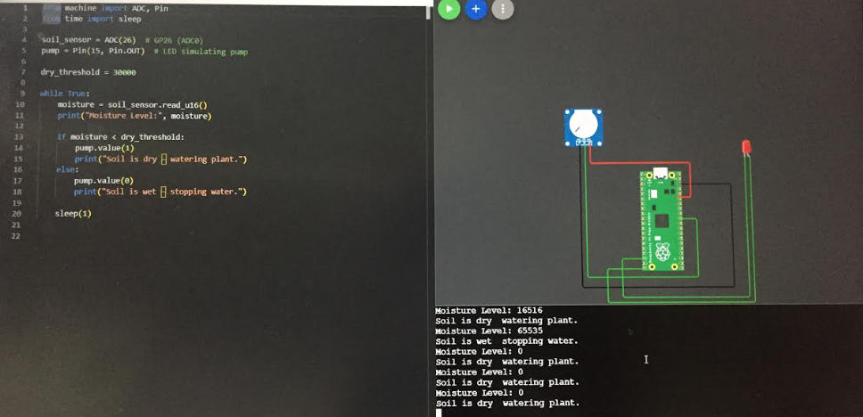
IMPLEMENTATION USING WOKWI

Slide 6
REAL TIME APPLICATIONS
Home Gardens – Automatically waters indoor and outdoor plants.
Greenhouses – Maintains controlled watering for better crop yield.
Agricultural Farms – Scalable for larger fields to improve irrigation efficiency.
Offices and Commercial Spaces – Keeps decorative plants healthy without manual care.
Smart City Projects – Supports urban green spaces with automated maintenance
.
Nurseries and Plant Shops – Ensures consistent watering for multiple plant types.

Slide 7
CODE
from machine import ADC, Pin
from time import sleep
soil_sensor = ADC(26) # GP26 (ADC0)
pump = Pin(15, Pin.OUT) # LED simulating pump
dry_threshold = 30000
while True:
moisture = soil_sensor.read_u16()
print("Moisture Level:", moisture)
if moisture < dry_threshold:
pump.value(1)
print("Soil is dry – watering plant.")
else:
pump.value(0)
print("Soil is wet – stopping water.")
sleep(1)

